Slide 1

BOOHOO
G L O B A L
E X P A N S I O N
F A S H I O N P R E S E N T A T I O N
B Y
M A R Y A B I A E D I E T E

Slide 2

ABOUT BRAZIL
Brazil, also known by its formal names the Federative Republic of Brazil and Repblica Federativa do Brasil, is a South American nation that makes up half of the continent's landmass. Despite having a larger area than the 48 contiguous states of the United States, it is the fifth-largest country in the world, behind only Russia, Canada, China, and the United States.
Brazilians are well known for their legendary carnival celebration and for having outstanding soccer players like Pelé and Neymar. Brazil is also well-known for its lush forests, stunning waterfalls, and tropical beaches.
After the crisis that occurred seven years ago, when the GDP shrank by about 7%, the nation is still attempting to restore itself. Brazil hasn't been able to continue its previous decade-long trend of rapid growth since that time.
According to (Worldometer, 2019) elaboration of the most recent United Nations data as of Monday, July 11, 2022, there are 215,608,457 people living in Brazil on that day. Brazil has a population density of 25 per Km2 (66 people per mi2). 8,358,140 Km2 is the total area of the land (3,227,095 sq. miles). Urban areas are home to 87.6% of the population (186,217,070 people in 2020). Brazil is largely populated by youth with a median age of 33.5 years.
Notes:
Brazil, also known by its formal names Federative Republic of Brazil and Repblica Federativa do Brasil, is a South American nation that makes up half of the continent's landmass. Despite having a larger area than the 48 contiguous states of the United States, it is the fifth-largest country in the world, behind only Russia, Canada, China, and the United States.
Brazilians are well known for their legendary carnival celebration and for having outstanding soccer players like Pelé and Neymar. Brazil is also well-known for its lush forests, stunning waterfalls, and tropical beaches.
Brazil is a global leader in mining, agriculture, manufacturing, and it also has a robust and expanding service industry. It is a major producer of a variety of minerals, including as iron ore, tin, bauxite (the ore of aluminum), manganese, gold, quartz, diamonds, and other jewels, and it also exports significant amounts of consumer goods like steel, cars, electronics, and quartz. Brazil is the world's largest producer of sugar, soy, and cattle. However, since the mid-20th century, when the country started to quickly urbanize and utilize its mineral, industrial, and hydropower resources, the relative importance of Brazilian agriculture has been diminishing (Poppino & E. Bradford Burns, 2019).
After the crisis that occurred seven years ago, when the GDP shrank by about 7%, the nation is still attempting to restore itself. Brazil hasn't been able to continue its previous decade-long trend of rapid growth since that time. But in recent years, the Brazilian economy has been making gradual but steady progress toward recovery. GDP increased by an anticipated 5.2% in 2021, primarily due to increased commodity exports and a gradual reopening of the economy. Brazil's GDP Growth Rate was 0.55% on average from 1996 to 2022, with record highs of 7.80% in the third quarter of 2020 and record lows of -8.90% in the second. Brazil's GDP was 2465.19 USD billion in 2012; it drastically decreased to 1795.7 USD billion in 2016, increased to 20633.51 USD billion the year after, then decreased again the following year to 1916.95 USD billion, further decreased to 1448.57 USD billion in 2020, followed by a rebound in 2021 to 1608.98 USD billion (Trading Economics, 2019). The largest economy in South America is anticipated to expand more slowly in the upcoming years, with the IMF projecting GDP growth of 1.5% in 2022 and 2.5% in 2023.
According to (Worldometer, 2019) elaboration of the most recent United Nations data as of Monday, July 11, 2022, there are 215,608,457 people living in Brazil as of that day. Brazil has a population density of 25 per Km² (66 people per mi²). 8,358,140 Km² is the total area of the land (3,227,095 sq. miles). Urban areas are home to 87.6% of the population (186,217,070 people in 2020). Brazil is largely populated by youth with a median age of 33.5 years.
Based on the cultural character of the Hofstede’s, Brazil is split into various categories:
High Power Distance: Brazil is a country with a high-power distance, which means that people there appreciate and acknowledge the disparities and inequalities that exist in society, particularly those that are related to class, wealth, and age. Organizational structure is important in enterprises, and there is normally one supervisor who is fully responsible.
Collectivist: Brazilians place a high value on their families, both close and distant, and this family dynamic is also exhibited in the workplace. Everyone in the family is expected to be faithful, and this loyalty is rewarded by the family as a whole being strong. Brazil is a collectivist society, which means that strong, recognizable groups are important and promoted.
Masculinity: Masculinity is in aspect is intermediate, Brazil aspires to demonstrate both masculine qualities by being the best and feminine qualities by focusing on quality of life.
High Uncertainty Avoidance: Brazil, a country with a high uncertainty avoidance dimension, attempts to regulate its future through a variety of rules and laws. Brazilians are concerned by ambiguous situations, and a juridical system provides order to daily life.
Intermediate Long-Term Orientation: Brazil is virtually exactly in the middle of this dimension, which means that it uses both strategies equally. Brazil can be wary of change due to its high level of uncertainty avoidance, and it frequently turns to traditional solutions to problems.
High Indulgence: While recent recessions have undoubtedly tempered Brazil's propensity for hasty purchases, the Brazilian spirit won't be permanently dimmed. A high level of indulgence implies that Brazilians' passionate, emotional nature makes them more prone to enjoying life.

Slide 3
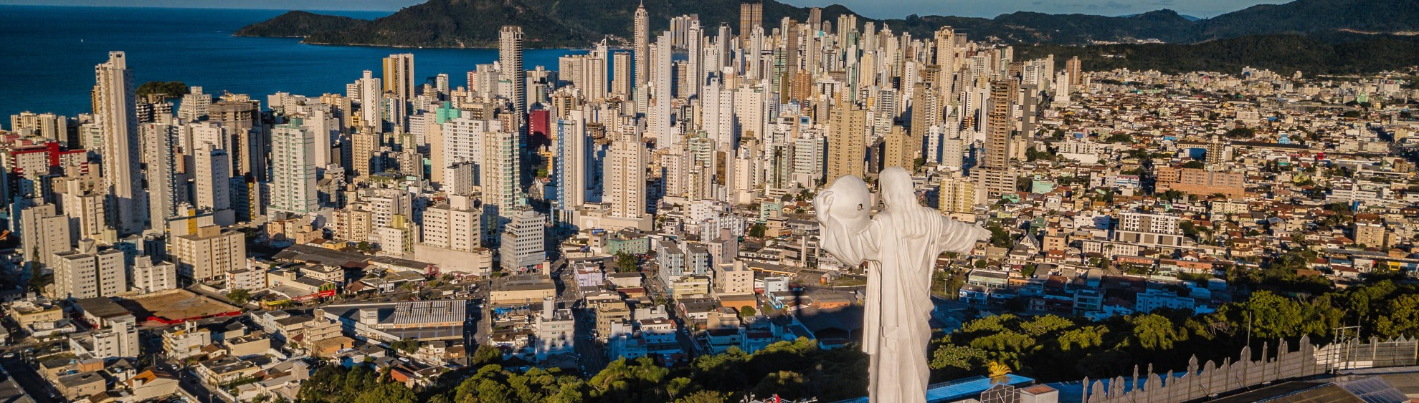
POLITICAL FACTORS
POLITICAL STRUCTURE
Each of Brazil's presidential candidates has a unique perspective on business. With Jair Bolsonaro, his goal is to limit Chinese companies' investment in Brazi, which might signal the start of a drop in foreign investment.
TAX
The Brazilian Congress is implementing tax measures that may have an impact on employment and company, particularly foreign companies that only depend on imports.
CORRUPTION
Brazil is the 96th least corrupt country out of 180 countries, according to Transparency International's 2021 Corruption Perceptions Index. However, the government is putting up a strong struggle against this with the help of a program billed as integrity.
FOREIGN RELATIONS
Brazil has strong diplomatic ties with the US as well as its neighbours, including Argentina and Venezuela.
Notes:
Political Structure
The next presidential election in Brazil will take place in October 2022, and this is seen as a bad time to conduct business.
Each of Brazil's presidential candidates has a unique perspective on business. It is now difficult to forecast Luiz Inácio Lula da Silva's impact on business, and commentators are more focused on the issue of whether he can run for president at all. The second most popular presidential contender is Jair Bolsonaro, and in his opinion In terms of business, his goal is to limit Chinese companies' investment in Brazil, which might signal the start of a drop in foreign investment in Brazil (Brazil, 2018).
Corruption
Brazil is the 96th least corrupt country out of 180 countries, according to Transparency International's 2021 Corruption Perceptions Index, which gives the country a score of 38 out of 100 (Brazil Corruption Index, 2019) and organized crime is a serious issue in various regions of the nation. However, the government is putting up a strong struggle against this with the help of a program billed as integrity.
Tax
The Brazilian Congress is implementing tax measures that may have an impact on employment and company, particularly foreign companies that only depend on imports.
Business Compatibility
Brazil is ranked 125th in the world for doing business
Starting a business in Brazil has a score of 176 out of 190
Foreign Relations
Brazil has strong diplomatic ties with the US as well as its neighbours, including Argentina and Venezuela.
Environmental Waste
It is clear that the Brazilian government has made conscious efforts to address the trash problem and has put policies in place to ensure this is carried out. Brazil is on the right track to develop a framework for managing water resources that is in line with the water-related OECD legislative instrument. Brazil has created extended producer responsibility programs for solid waste management and closed numerous unregulated trash dumps. The rates of waste collection and the proportion of separate collection are gradually rising. Open-air landfills still exist, non-selective collection practices are still prevalent, and trash recovery has not improved since 2010.
In terms of waste management from the fashion industry, which is given increasing attention. Since January 2008, Brazil has formally imported more than 223 thousand tons of trash at a cost of US$257.9 million. Due to a lack of selective waste collection during that time, the nation lost out on about $12 billion in revenue because 78 percent of the solid waste that was generated domestically was not recycled. More is absorbed by the national industry that uses recycled materials as raw materials for garments, cars, packages, and other products than the nation collects and recycles. causing a need for imports. Districts have a constitutional duty to distribute urban waste, yet just 7% of Brazil's 5,564 municipalities collect recycled waste (Amaral et al., 2018).
The fact that Brazil imports rags and garbage (including silk, wool, cotton, and other synthetic and artificial fibers) shows that there is an internal market for textile waste that has to be understood and taken advantage of. Brazil imported 8,941,986 kg of textile rags and shreds in 2015 for US$ 5,848,422.00, or the value of the commodity excluding freight (Amaral et al., 2018).
Recommendations
Boohoo will increase its market share in Brazil after making a commitment to offer recyclable clothing to help the nation lessen its environmental effect. The retail company can also set up a system for gathering used things and working with companies to recycle worn clothing, which will ultimately reduce pollution significantly. People will consequently be more likely to be concerned about environmental problems and climate change.
The main difficulties businesses in Brazil confront include dealing with building licenses, registering properties, paying taxes, and selling across borders. To ensure speedy processing, Boohoo must hire professionals.
Every sector needs to receive proper reporting in order to combat corruption.

Slide 4
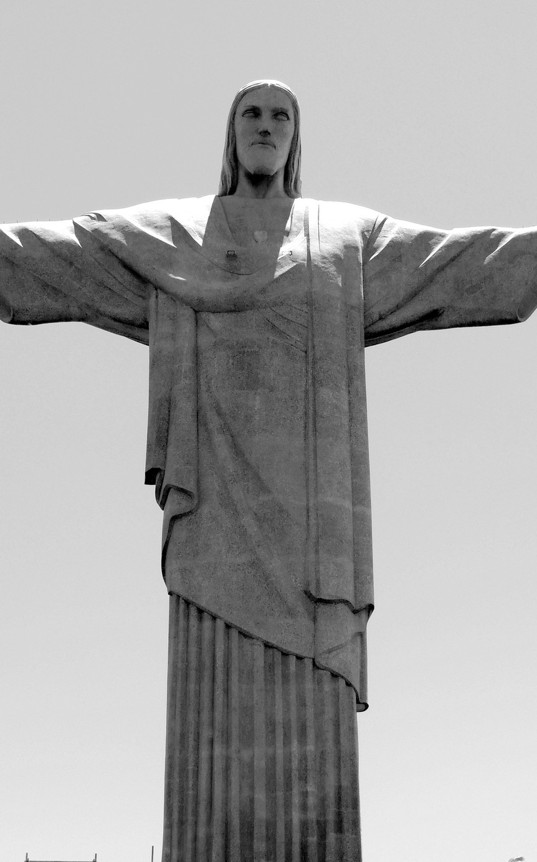
POLITICAL FACTORS CONTD.
RECOMMENDATIONS
Boohoo will increase its market share in Brazil after making a commitment to offer recyclable clothing to help the nation lessen its environmental effect. The retail company can also set up a system for gathering used things and working with companies to recycle worn clothing, which will ultimately reduce pollution significantly. People will consequently be more likely to be concerned about environmental problems and climate change.
The main difficulties businesses in Brazil confront include dealing with building licenses, registering properties, paying taxes, and selling across borders. To ensure speedy processing, Boohoo must hire professionals.
Every sector needs to receive proper
reporting in order to combat corruption.
It is clear that the Brazilian government has made conscious efforts to address the trash problem and has implemented policies to ensure this is carried out. Brazil is on the right track to developing a framework for managing water resources that aligns with the water- related OECD legislative instrument. Brazil has created extended producer responsibility programs for solid waste management and closed numerous unregulated trash dumps. The rates of waste collection and the proportion of separate collections are gradually rising. Open-air landfills still exist, non- selective collection practices are still prevalent, and trash recovery has not improved since 2010.
Notes:
Political Structure
The next presidential election in Brazil will take place in October 2022, and this is seen as a bad time to conduct business.
Each of Brazil's presidential candidates has a unique perspective on business. It is now difficult to forecast Luiz Inácio Lula da Silva's impact on business, and commentators are more focused on the issue of whether he can run for president at all. The second most popular presidential contender is Jair Bolsonaro, and in his opinion In terms of business, his goal is to limit Chinese companies' investment in Brazil, which might signal the start of a drop in foreign investment in Brazil (Brazil, 2018).
Corruption
Brazil is the 96th least corrupt country out of 180 countries, according to Transparency International's 2021 Corruption Perceptions Index, which gives the country a score of 38 out of 100 (Brazil Corruption Index, 2019) and organized crime is a serious issue in various regions of the nation. However, the government is putting up a strong struggle against this with the help of a program billed as integrity.
Tax
The Brazilian Congress is implementing tax measures that may have an impact on employment and company, particularly foreign companies that only depend on imports.
Business Compatibility
Brazil is ranked 125th in the world for doing business
Starting a business in Brazil has a score of 176 out of 190
Foreign Relations
Brazil has strong diplomatic ties with the US as well as its neighbours, including Argentina and Venezuela.
Environmental Waste
It is clear that the Brazilian government has made conscious efforts to address the trash problem and has put policies in place to ensure this is carried out. Brazil is on the right track to develop a framework for managing water resources that is in line with the water-related OECD legislative instrument. Brazil has created extended producer responsibility programs for solid waste management and closed numerous unregulated trash dumps. The rates of waste collection and the proportion of separate collection are gradually rising. Open-air landfills still exist, non-selective collection practices are still prevalent, and trash recovery has not improved since 2010.
In terms of waste management from the fashion industry, which is given increasing attention. Since January 2008, Brazil has formally imported more than 223 thousand tons of trash at a cost of US$257.9 million. Due to a lack of selective waste collection during that time, the nation lost out on about $12 billion in revenue because 78 percent of the solid waste that was generated domestically was not recycled. More is absorbed by the national industry that uses recycled materials as raw materials for garments, cars, packages, and other products than the nation collects and recycles. causing a need for imports. Districts have a constitutional duty to distribute urban waste, yet just 7% of Brazil's 5,564 municipalities collect recycled waste (Amaral et al., 2018).
The fact that Brazil imports rags and garbage (including silk, wool, cotton, and other synthetic and artificial fibers) shows that there is an internal market for textile waste that has to be understood and taken advantage of. Brazil imported 8,941,986 kg of textile rags and shreds in 2015 for US$ 5,848,422.00, or the value of the commodity excluding freight (Amaral et al., 2018).
Recommendations
Boohoo will increase its market share in Brazil after making a commitment to offer recyclable clothing to help the nation lessen its environmental effect. The retail company can also set up a system for gathering used things and working with companies to recycle worn clothing, which will ultimately reduce pollution significantly. People will consequently be more likely to be concerned about environmental problems and climate change.
The main difficulties businesses in Brazil confront include dealing with building licenses, registering properties, paying taxes, and selling across borders. To ensure speedy processing, Boohoo must hire professionals.
Every sector needs to receive proper reporting in order to combat corruption.

Slide 5

Economic Factors
STATISTICS
Brazil: Growth rate of the real gross domestic product (GDP) from 2017 to 2027 (compared to the previous year)
GDP
After the crisis that occurred seven years ago, when the GDP shrank by about 7%, the nation is still attempting to restore itself. Brazil hasn't been able to continue its previous decade-long trend of rapid growth since that time.
5%
GDP growth compared to previous year
4%
3%
The predicted rate of inflation in 2021 exceeded the Central Bank's target of 5.25% and was at 7.7%. However, it is anticipated that inflation will fall to 5.3% in 2022 and 3.5% in 2023. Inflation was rather high, and credit conditions were more restrictive, which reduced consumer expenditure in 2021 (Santander, 2010).
2%
1%
0%
-1%
Brazil's unemployment rate increased in 2021, rising to an anticipated 13.8%, primarily as a result of a protracted period of slow growth while the nation recovered from the pandemic's effects.
-2%
-3%
-4%
2017 2018 2019 2020 2021 2022 2023 2024 2025 2026 2027
Notes:
General Overview
Brazil is a global leader in mining, agriculture, manufacturing, and it also has a robust and expanding service industry. It is a major producer of a variety of minerals, including as iron ore, tin, bauxite (the ore of aluminum), manganese, gold, quartz, diamonds, and other jewels, and it also exports significant amounts of consumer goods like steel, cars, electronics, and quartz. Brazil is the world's largest producer of sugar, soy, and cattle. However, since the mid-20th century, when the country started to quickly urbanize and utilize its mineral, industrial, and hydropower resources, the relative importance of Brazilian agriculture has been diminishing (Poppino & E. Bradford Burns, 2019).
After the crisis that occurred seven years ago, when the GDP shrank by about 7%, the nation is still attempting to restore itself. Brazil hasn't been able to continue its previous decade-long trend of rapid growth since that time. But in recent years, the Brazilian economy has been making gradual but steady progress toward recovery. GDP increased by an anticipated 5.2% in 2021, primarily due to increased commodity exports and a gradual reopening of the economy. Brazil's GDP Growth Rate was 0.55% on average from 1996 to 2022, with record highs of 7.80% in the third quarter of 2020 and record lows of -8.90% in the second. Brazil's GDP was 2465.19 USD billion in 2012; it drastically decreased to 1795.7 USD billion in 2016, increased to 20633.51 USD billion the year after, then decreased again the following year to 1916.95 USD billion, further decreased to 1448.57 USD billion in 2020, followed by a rebound in 2021 to 1608.98 USD billion (Trading Economics, 2019). The largest economy in South America is anticipated to expand more slowly in the upcoming years, with the IMF projecting GDP growth of 1.5% in 2022 and 2.5% in 2023.
Inflation Rate
The predicted rate of inflation in 2021 exceeded the Central Bank's target of 5.25% and was at 7.7%. However, it is anticipated that inflation will fall to 5.3% in 2022 and 3.5% in 2023. Inflation was rather high, and credit conditions were more restrictive, which reduced consumer expenditure in 2021 (Santander, 2010).
Unemployment Rate
Brazil's unemployment rate increased in 2021, rising to an anticipated 13.8%, primarily as a result of a protracted period of slow growth while the nation recovered from the pandemic's effects. The official unemployment survey indicates that some 32 million individuals are underutilised, which means that they are either not working or working less than they could, leading the government to suspect that the real numbers are substantially higher (Santander, 2010). Due to the country's prominence in the textile and fashion industries as well as the degree of unemployment, it will be simple to develop a competent labor force in Brazil.
Currency
Consumers profit from Brazil's strong currency, but companies suffer as a result of the country's base interest rate, which is among the highest in the world at 12.5% when annual inflation is at 7%. Brazilian policymakers fear that too much cheap money is moving in their direction for short-term speculation, driving up the real and raising the possibility of capital flight in the event of market gyrations.
Access To Credit
In the past, getting credit in Brazil has been expensive and challenging. For small firms and sole owners looking to borrow modest amounts to pay for inventory or invest in new enterprises, this presents a hurdle. However, new fintech companies are sprouting up in the present and future years, making it simple for small businesses to receive credit and giving financial organizations a chance to compete with major, established banks.
Globalization
Trade liberalization has increased Brazil's international trade as well as inflows of foreign direct investment. Brazil has gained increasing clout inside international institutions throughout the era of globalization and economic expansion, and it has grown to be a significant player in world affairs. Controlling globalization and implementing effective economic reforms are necessary for it to benefit Brazil. Since the turn of the new century, Brazil has reaped the rewards of globalization (Globalization in Brazil: How Has Globalization Affected the Economic, Political, and Social Conditions in Brazil?, n.d.). This took place in the middle of the 1990s.

Slide 6


Currency
ECONOMIC FACTORS
CONTD.
Consumers profit from Brazil's strong currency, but companies suffer as a result of the country's base interest rate, which is among the highest in the world at 12.5% when annual inflation is at 7%.
In the past, getting credit in Brazil has been expensive and challenging. For small firms and sole owners looking to borrow modest amounts to pay for inventory or invest in new enterprises, this presents a hurdle.
Credit
Brazil has gained increasing clout inside international institutions throughout the era of globalization and economic expansion, and it has grown to be a significant player in world affairs.
Globalization
Notes:
General Overview
Brazil is a global leader in mining, agriculture, manufacturing, and it also has a robust and expanding service industry. It is a major producer of a variety of minerals, including as iron ore, tin, bauxite (the ore of aluminum), manganese, gold, quartz, diamonds, and other jewels, and it also exports significant amounts of consumer goods like steel, cars, electronics, and quartz. Brazil is the world's largest producer of sugar, soy, and cattle. However, since the mid-20th century, when the country started to quickly urbanize and utilize its mineral, industrial, and hydropower resources, the relative importance of Brazilian agriculture has been diminishing (Poppino & E. Bradford Burns, 2019).
After the crisis that occurred seven years ago, when the GDP shrank by about 7%, the nation is still attempting to restore itself. Brazil hasn't been able to continue its previous decade-long trend of rapid growth since that time. But in recent years, the Brazilian economy has been making gradual but steady progress toward recovery. GDP increased by an anticipated 5.2% in 2021, primarily due to increased commodity exports and a gradual reopening of the economy. Brazil's GDP Growth Rate was 0.55% on average from 1996 to 2022, with record highs of 7.80% in the third quarter of 2020 and record lows of -8.90% in the second. Brazil's GDP was 2465.19 USD billion in 2012; it drastically decreased to 1795.7 USD billion in 2016, increased to 20633.51 USD billion the year after, then decreased again the following year to 1916.95 USD billion, further decreased to 1448.57 USD billion in 2020, followed by a rebound in 2021 to 1608.98 USD billion (Trading Economics, 2019). The largest economy in South America is anticipated to expand more slowly in the upcoming years, with the IMF projecting GDP growth of 1.5% in 2022 and 2.5% in 2023.
Inflation Rate
The predicted rate of inflation in 2021 exceeded the Central Bank's target of 5.25% and was at 7.7%. However, it is anticipated that inflation will fall to 5.3% in 2022 and 3.5% in 2023. Inflation was rather high, and credit conditions were more restrictive, which reduced consumer expenditure in 2021 (Santander, 2010).
Unemployment Rate
Brazil's unemployment rate increased in 2021, rising to an anticipated 13.8%, primarily as a result of a protracted period of slow growth while the nation recovered from the pandemic's effects. The official unemployment survey indicates that some 32 million individuals are underutilised, which means that they are either not working or working less than they could, leading the government to suspect that the real numbers are substantially higher (Santander, 2010). Due to the country's prominence in the textile and fashion industries as well as the degree of unemployment, it will be simple to develop a competent labor force in Brazil.
Currency
Consumers profit from Brazil's strong currency, but companies suffer as a result of the country's base interest rate, which is among the highest in the world at 12.5% when annual inflation is at 7%. Brazilian policymakers fear that too much cheap money is moving in their direction for short-term speculation, driving up the real and raising the possibility of capital flight in the event of market gyrations.
Access To Credit
In the past, getting credit in Brazil has been expensive and challenging. For small firms and sole owners looking to borrow modest amounts to pay for inventory or invest in new enterprises, this presents a hurdle. However, new fintech companies are sprouting up in the present and future years, making it simple for small businesses to receive credit and giving financial organizations a chance to compete with major, established banks.
Globalization
Trade liberalization has increased Brazil's international trade as well as inflows of foreign direct investment. Brazil has gained increasing clout inside international institutions throughout the era of globalization and economic expansion, and it has grown to be a significant player in world affairs. Controlling globalization and implementing effective economic reforms are necessary for it to benefit Brazil. Since the turn of the new century, Brazil has reaped the rewards of globalization (Globalization in Brazil: How Has Globalization Affected the Economic, Political, and Social Conditions in Brazil?, n.d.). This took place in the middle of the 1990s.

Slide 7
Population
According to (Worldometer, 2019) elaboration of the most recent United Nations data as of Monday, July 11, 2022, there are 215,608,457 people living in Brazil as of that day. Brazil has a population density of 25 per Km2 (66 people per mi2). 8,358,140 Km2 is the total area of the land (3,227,095 sq. miles). Urban areas are home to 87.6% of the population (186,217,070 people in 2020). Brazil is largely populated by youth with a median age of 33.5 years.
Generational Shifts
Brazil, where youth predominate, is also feeling the effects of this generational shift. The rising Millennial and Generation Z generations are tech-savvy and picky about the information they get. With the help of social media players, advertising in the fashion business now has numerous degrees.
Social Sectors
Brazil's average social mobility score in 2020 was 52.1 out of a possible 100 points. Brazil performed best in the area of technology access, earning 67.8 points out of 100, followed by the health sector with 62 points and education access with 54.2 points (Social Mobility Index in Brazil by Area 2020, n.d.).
Socio-Cultural Factors
Notes:
Population
According to (Worldometer, 2019) elaboration of the most recent United Nations data as of Monday, July 11, 2022, there are 215,608,457 people living in Brazil as of that day. Brazil has a population density of 25 per Km² (66 people per mi²). 8,358,140 Km² is the total area of the land (3,227,095 sq. miles). Urban areas are home to 87.6% of the population (186,217,070 people in 2020). Brazil is largely populated by youth with a median age of 33.5 years.
Generational Shifts
The fashion industry is currently transforming as a result of the generational attitude shift. Brazil, where youth predominate, is also feeling the effects of this generational shift. The rising Millennial and Generation Z generations are tech-savvy and picky about the information they get. With the help of social media players, advertising in the fashion business now has numerous degrees. The brands connected to influencers are revolutionizing the fashion sector. Nati Vozza, a fashion influencer, sold her business BYNV for R$210 million as a result of the power of her name and her 1.2 million followers. In 2020, the company made R$158 million in revenue. For several years, her image served as the primary marketing tool for BYNV, which fuelled the expansion and support of other fashion influencers (Fashion Law 2021, n.d.).
Social Sectors
Brazil's average social mobility score in 2020 was 52.1 out of a possible 100 points. Brazil performed best in the area of technology access, earning 67.8 points out of 100, followed by the health sector with 62 points and education access with 54.2 points (Social Mobility Index in Brazil by Area 2020, n.d.).
Brazil faces a number of difficulties in the workplace, including high rates of youth unemployment and underemployment, poor educational standards and a skills gap, a significant percentage of low-wage, low-productivity positions, and socioeconomic inequities. The economic recovery continues to be exceedingly inequitable throughout the states and between various social classes. The job market will see a number of changes at the same time. The two main factors that will have a medium-term impact on the Brazilian labor market are technological advancements and an aging population (Accept Terms and Conditions on JSTOR, n.d.).

Slide 8

Recommendations
One of the Brazilian e-commerce segments with the quickest recent growth has been the fashion industry. More and more new businesses are starting every day with a dedicated online focus, so it's not only traditional retail stores that are betting on having an online presence. It is also important to note that, according to statistics from Criteo, 20% of fashion online sales in Brazil are made on mobile devices, indicating a market with significant room for expansion.
Boohoo can profit from Brazil's rapidly expanding e-commerce market by providing cashback incentives to customers who purchase particular products, limited editions of particular clothing styles (scarcity is the name of the game for this type of promotion), surprise boxes that customers can use to give gifts to their loved ones, vouchers before and during eCommerce sales that can be made available on all social media platforms, and competitions.
Notes:
Recommendations
One of the Brazilian e-commerce segments with the quickest recent growth has been the fashion industry. More and more new businesses are starting every day with a dedicated online focus, so it's not only traditional retail stores that are betting on having an online presence. It is also important to note that, according to statistics from Criteo, 20% of fashion online sales in Brazil are made on mobile devices, indicating a market with significant room for expansion.
Boohoo can profit from Brazil's rapidly expanding e-commerce market by providing cashback incentives to customers who purchase particular products, limited editions of particular clothing styles (scarcity is the name of the game for this type of promotion), surprise boxes that customers can use to give gifts to their loved ones, vouchers before and during eCommerce sales that can be made available on all social media platforms, and competitions.

Slide 9
TECHNOLOGICAL FACTORS
DATA SECURITY
Brazil ranks 3rd globally in terms of the prevalence of malware, bots, spam, and phishing attacks, accounting for 5.4% of all global threat detections.
CYBERSECURITY
Brazil is the top-ranked country in Latin America for cybersecurity and comes in at number 18 on the Global Cybersecurity Index
About 165.46 million people in Brazil used social media in 2022. By 2027, this number is anticipated to increase to around 188.35 million users. Brazil has over 167.7 million internet users in 2022. In the South American nation that year, 77.87% of people had access to the internet. The number of Internet users is predicted to reach
189.99 million by 2027.
MOBILE USAGE
A nationwide broadband plan was introduced by the Brazilian government in 2016 to increase the country's access to technology.
Notes:
About 165.46 million people in Brazil used social media in 2022. By 2027, this number is anticipated to increase to around 188.35 million users. Brazil has over 167.7 million internet users in 2022. In the South American nation that year, 77.87%of people had access to the internet. The number of Internet users is predicted to reach 189.99 million by 2027.
Brazil ranks 3rd globally in terms of the prevalence of malware, bots, spam, and phishing attacks, accounting for 5.4% of all global threat detections.
Brazil is the top-ranked country in Latin America for cybersecurity and comes in at number 18 on the Global Cybersecurity Index.
A nationwide broadband plan was introduced by the Brazilian government in 2016 to increase the country's access to technology.

Slide 10
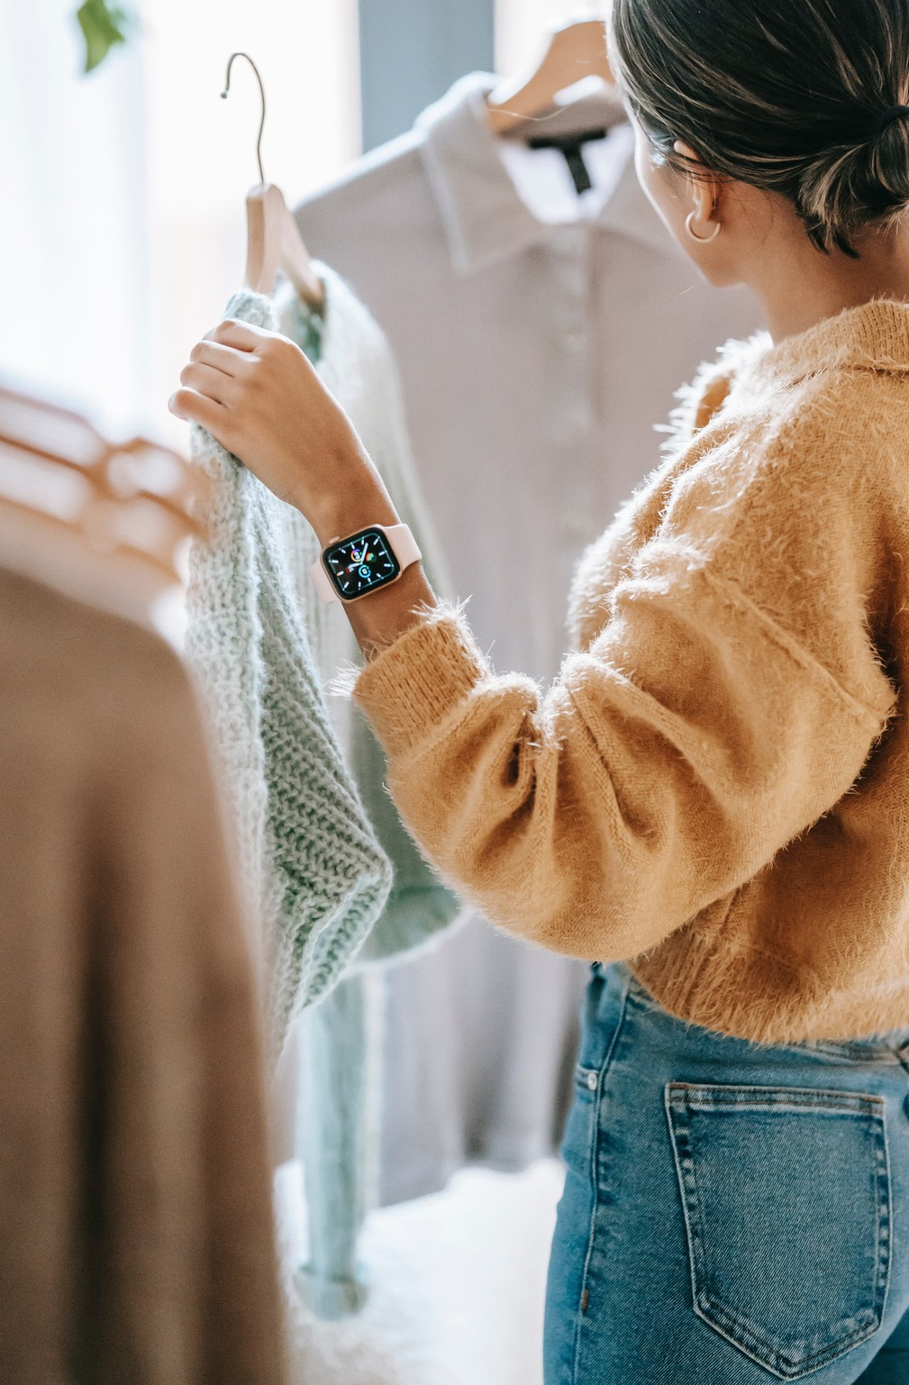

Thanks to advancements in technology, fashion is becoming more accessible, and the process is getting more convenient. Boohoo may benefit from this trend by establishing an online fashion presence on websites like Instagram, Pinterest, YouTube, Tik Tok, and retail stores. Younger generations like to purchase online. The development of a virtual try-on platform for online customers would also be advantageous to the business. 2018 saw the announcement of Tommy Hilfiger's collaboration with IBM and the Fashion Institute of Technology. The "Reimagine Retail" project uses IBM AI techniques to figure out:
current trends in the fashion industry
opinions of Tommy Hilfiger's items and runway photos among consumers
Recurring themes in popular patterns, shapes, colours, and fashion trends
Human designers were then provided with knowledge from the AI system so they could utilize it to make educated design decisions for their upcoming collection. Boohoo can emulate Tommy Hilfiger by incorporating AI into its collection development.
RECOMMENDATION
Notes:
Recommendation
Thanks to advancements in technology, fashion is becoming more accessible, and the process is getting more convenient. Boohoo may benefit from this trend by establishing an online fashion presence on websites like Instagram, Pinterest, YouTube, Tik Tok, and retail stores. Younger generations like to purchase online. The development of a virtual try-on platform for online customers would also be advantageous to the business.
2018 saw the announcement of Tommy Hilfiger's collaboration with IBM and the Fashion Institute of Technology. The "Reimagine Retail" project uses IBM AI techniques to figure out:
current trends in the fashion industry
opinions of Tommy Hilfiger's items and runway photos among consumers
Recurring themes in popular patterns, shapes, colors, and fashion trends
Human designers were then provided with knowledge from the AI system so they could utilize it to make educated design decisions for their upcoming collection. Boohoo can emulate Tommy Hilfiger by incorporating AI into their collection development.

Slide 11
The Uruguay Round and MERCOSUR trade accords, which were negotiated at the beginning of the 1990s, have been Brazil's primary trade policy goals. A major item on its trade agenda is to improve the conditions for Brazilian products to enter international markets (WTO | Trade Policy Review - Brazil 2000, n.d.).
Brazil was able to quickly implement trade freedom, which resulted in the removal of non-tariff barriers, a reduction in tariffs, and the establishment of Mercosur in Brazil.
Brazil's infrastructure underinvestment necessitates the urgent need for trade strategy that will lower trade-related expenses
Trade Policies
Notes:
The Uruguay Round and MERCOSUR trade accords, which were negotiated at the beginning of the 1990s, have been Brazil's primary trade policy goals. A major item on its trade agenda is to improve the conditions for Brazilian products to enter international markets (WTO | Trade Policy Review - Brazil 2000, n.d.).
Brazil was able to quickly implement trade freedom, which resulted in the removal of nontariff barriers, a reduction in tariffs, and the establishment of Mercosur in Brazil.
Brazil's infrastructure underinvestment necessitates the urgent need for trade strategy that will lower trade-related expenses.

Slide 12

LEGAL FACTORS
INTELLECTUAL PROPERTY
Both the creative market and intangible investments can be safeguarded by the Industrial Property Law (Law 9.279/96) or the Copyright Law (9.610/98).
TRADEMARK
Article 122 stipulates that trademarks must be visibly discernible, unique, and legitimate. For apparel specifically, most designs struggle to meet the demand for innovation and originality.
CONSUMER PROTECTION
According to articles 17 of Law No. 8.078/90 and 4 of Decree No. 7.962/13, e- commerce must make sure that customers have access to customer care and a communication channel, including social media platforms.
Notes:
Brazilian fashion law is cross-disciplinary and encompasses many different legal disciplines, not just intellectual property or trademarks. There are frequently issues with consumer, labor, contractual, tax, business, advertising, and even environmental legislation (Fashion Law 2021, n.d.-b).
Intellectual Property
Both the creative market and intangible investments can be safeguarded by the Industrial Property Law (Law 9.279/96) or the Copyright Law (9.610/98). Both adhere to The Agreement on Trade-Related Aspects of Intellectual Property Rights' (TRIPS') minimal criteria, which establishes a reasonably safe environment to deal with piracy and counterfeiting. Brazilian law guards against free riders while promoting innovation and investments in the fashion sector (Fashion Law 2021, n.d.-b).
Trademark
Article 122 stipulates that trademarks must be visibly discernible, unique, and legitimate. For apparel specifically, most designs struggle to meet the demand for innovation and originality. It is significant to note that the Brazilian PTO does not automatically begin the design's assessment. Brazilian PTO will move on with the examination of the design's novelty and originality if the owner makes a request (article 111 of the Industrial Property Law). A design cannot be protected by design since it lacks novelty and has been disclosed more than six months prior to the application date. Design protection is restricted to 15 years (5 years, extendable up to three times) (Fashion Law 2021, n.d.-b).
Consumer Protection
According to articles 17 of Law No. 8.078/90 and 4 of Decree No. 7.962/13, e-commerce must make sure that customers have access to customer care and a communication channel, including social media platforms. Customers who wish to modify their privacy settings or revoke their consent to having their data accessed must have access to the appropriate channel. There are other consumer protection laws available to protect the interest of the consumer in Brazil (Fashion Law 2021, n.d.-b).
Environmental Regulations
In Brazil, the Environmental Criminal Law (9605/98) and the National Policy for Solid Residues (lei 12.305/2010) are the legislation that apply (Fashion Law 2021, n.d.-b).

Slide 13
Accept Terms and Conditions on JSTOR. (n.d.). Www.jstor.org. https://www.jstor.org/stable/pdf/resrep22495.5.pdf
References
Amaral, M. C. do, Zonatti, W. F., Silva, K. L. da, Karam Junior, D., Amato Neto, J., & Baruque-Ramos, J. (2018). Industrial textile recycling and reuse in Brazil: case study and considerations concerning the circular economy. Gestão & Produção, 25(3), 431–443. https://doi.org/10.1590/0104-530x3305
Brazil Corruption Index. (2019, October 19). Tradingeconomics.com; TRADING ECONOMICS. https://tradingeconomics.com/brazil/corruption-index
Brazil, L. T. (2018, March 21). How Will the 2018 Brazilian Elections Affect Business? Biz Latin Hub. https://www.bizlatinhub.com/brazilian-elections-2018-affect- business/
Poppino, R. E., & E. Bradford Burns. (2019). Brazil - The economy. In Encyclopædia Britannica.
Santander. (2010). Economic and political outline Brazil - Santandertrade.com. Santandertrade.com. https://santandertrade.com/en/portal/analyse- markets/brazil/economic-political-outline
Trading Economics. (2019, March 24). Brazil GDP. Tradingeconomics.com; TRADING ECONOMICS. https://tradingeconomics.com/brazil/gdp
Worldometer. (2019). Brazil Population (2019) - Worldometers. Worldometers.info. https://www.worldometers.info/world-population/brazil-population/

